Slide 1

Introduction to WebGL
CS 418: Interactive Computer Graphics
Professor Eric Shaffer

Slide 2
The WebGL Rasterization Engine
WebGL relatively new (2011) 3D graphics support for web
WebGL advantages
runs in browser
naturally cross-platform
don’t need to obtain/build other libraries
gives you “windowing” for free
easy to publish/share your stuff
Disadvantages
Depends on how you feel about JavaScript
Performance can be tricky
Pretty low-level

Slide 3
Programming Language for CS 418
HTML
JavaScript
WebGL
WebGL version of the GLSL shading language (runs on GPU)
Chrome as default browser
Chrome DevTools to debug code
Some WebGL examples: https://www.chromeexperiments.com/webgl
Firefox is fine too…and probably Edge. We test in Chrome…

Slide 4
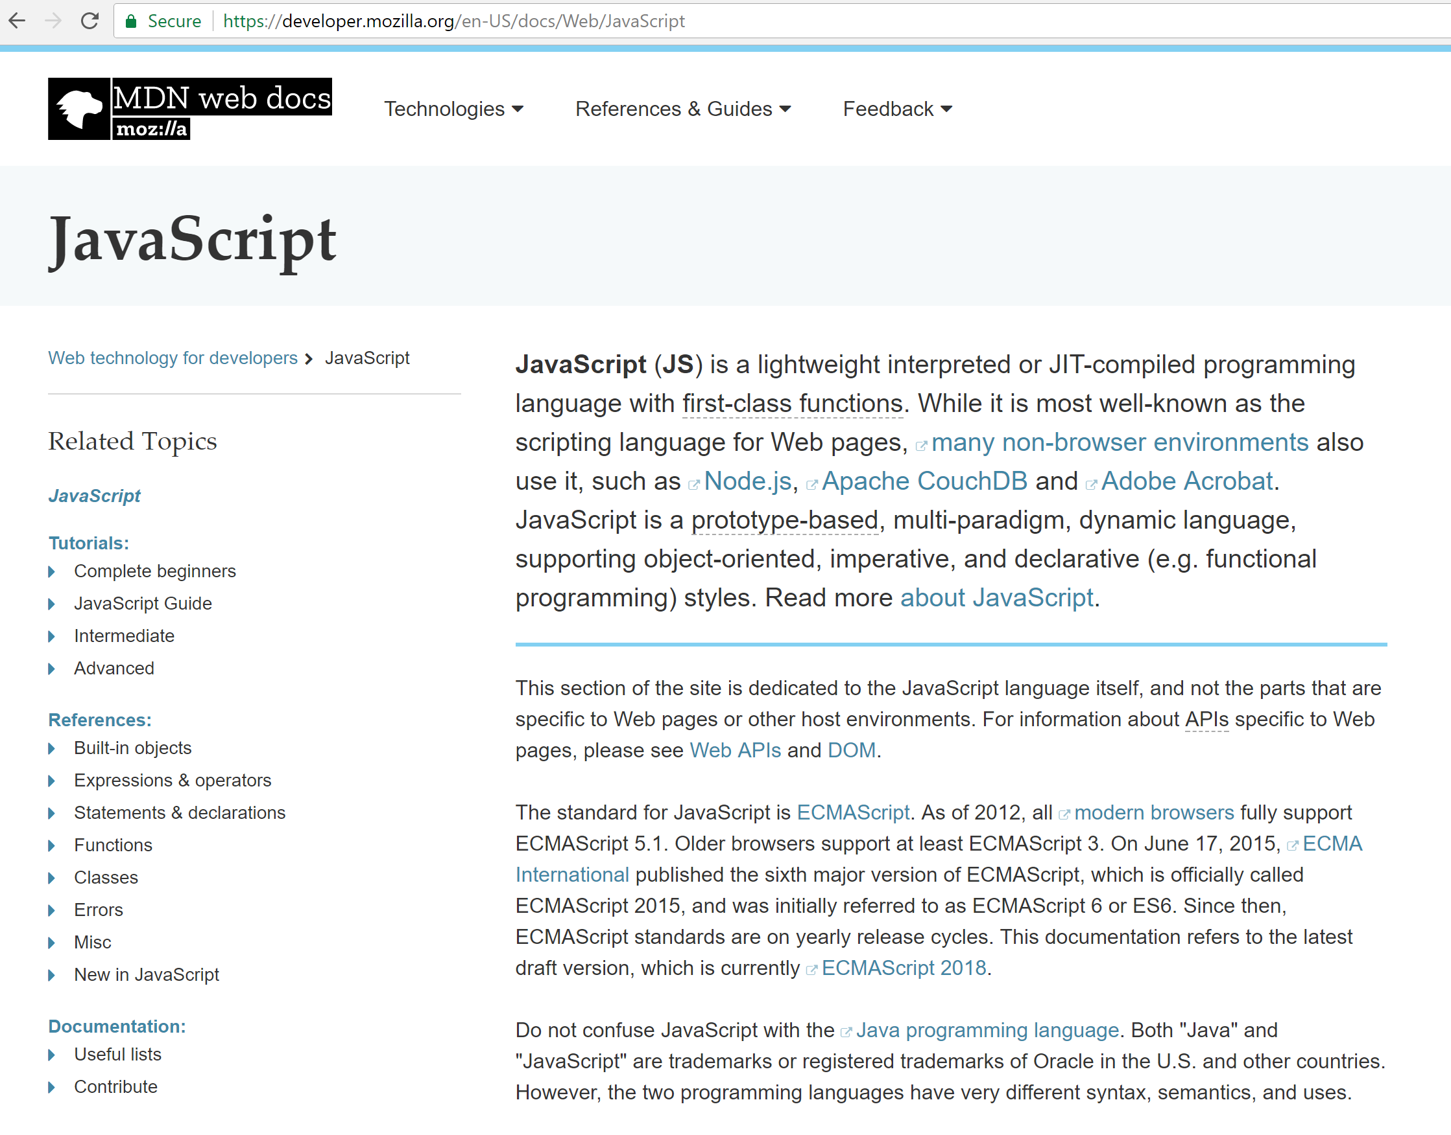
JavaScript
We will provide example code
You are responsible for learning what you need to complete the assignments
Mozilla reference/tutorials are quite good
https://developer.mozilla.org/en-US/docs/Web/JavaScript

Slide 5
What is WebGL? Let’s start with a word about OpenGL
Open standard for 3D graphics programming
Developed by Silicon Graphics in 1992
Available on most platforms…
Bindings available for lots of languages…
It’s low level
“Windowing” typically requires another library
e.g. GLUT
Version 3.0 (2008) introduced programmable shaders
Deprecated fixed-function pipeline
Vulkan API is the successor technology (still pretty new…2016ish)

Slide 6
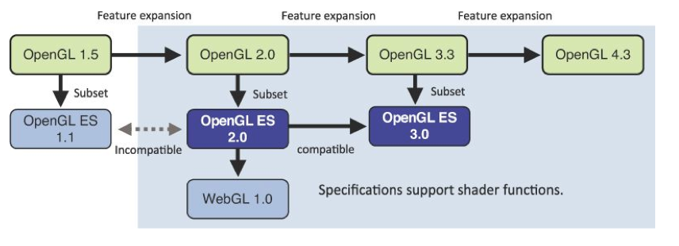
WebGL is not exactly OpenGL
Yes – you can use WebGL 2.0 in this course
Figure from WebGL Programming Guide: Interactive 3D Graphics Programming with WebGL by Matsuda and Lea

Slide 7
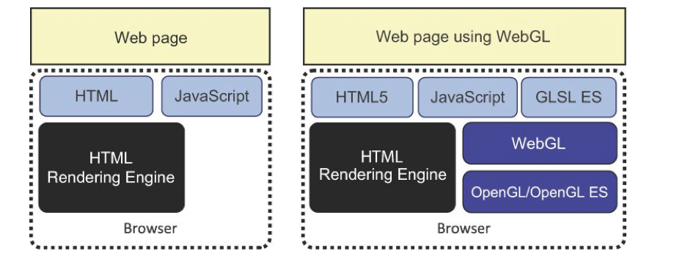
WebGL Application Structure
Figure from WebGL Programming Guide: Interactive 3D Graphics Programming with WebGL by Matsuda and Lea
Your application will generally just have HTML and JavaScript files

Slide 8
WebGL and GLSL
WebGL requires you provide shader programs
GLSL OpenGL Shading Language
C-like with
Matrix and vector types (2, 3, 4 dimensional)
Overloaded operators
C++ like constructors
WebGL functions compile, link and get information to shaders

Slide 9
Shaders
Shader source code will be in the HTML file or a JS file…usually
Vertex Shaders generally move vertices around
Projection, animation, etc.
Assign a value to the built-in variable gl_Position
Fragment Shaders generally determine a fragment color
Assign a value to the built-in variable gl_FragColor

Slide 10
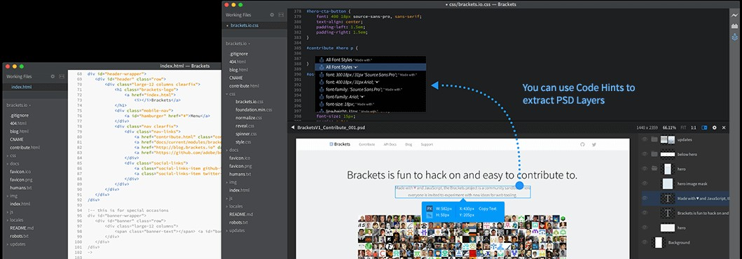
You Need a Text Editor
Brackets is a good choice…but whatever works for you is fine http://brackets.io/

Slide 11
Time to Write Some HTML
A few notes
We will keep everything in a single HTML file for this example
…for larger programs we will separate the HTML and JavaScript
Using WebGL entails writing a bunch of startup code
Complexity comes from the flexibility of the API
Will enable you to do really sophisticated stuff later on….
Eventually we’ll use a helper library for the startup code…
https://illinois-cs418.github.io/Examples/Hello%20Triangle.html

Slide 12
The HTML
<!DOCTYPE HTML>
<html lang="en">
<head>
<title>Hello Triangle</title>
<meta charset="utf-8">
</head>
<body onload="startup();">
<canvas id="myGLCanvas" width="500“ height="500">
</canvas>
</body>
</html>
We create an HTML page
We create an HTML5 <canvas> That is 500 x 500 pixels which we will draw into.
We give it an id so we can refer to it in the javascript that we will write.
onload specifies an entry point into the JavaScript we will write…a function named startup() will be called on a page load

Slide 13
Adding JavaScript
<script type="text/javascript"> var gl;
var canvas;
var shaderProgram;
var vertexBuffer;
function startup(){ canvas=document.getElementById("myGLCanvas"); gl=createGLContext(canvas); setupShaders(); setupBuffers(); gl.clearColor(0.0, 0.0, 0.0, 1.0); draw();
}
</script>
JavaScript is included inside <script> tags
We have some global variables…
…and our initial function calls some other functions.
Bolded functions are the ones we will write.
clearColor is a WebGL function that sets the initial color of the pixels in the raster
getElementByID is a Document Object Model (DOM) function that gets us a reference to the canvas created in the HTML document

Slide 14
Getting a WebGL Context
function createGLContext(canvas) {
var names = ["webgl", "experimental-webgl"]; var context = null;
for (var i=0; i < names.length; i++) {
try {
context = canvas.getContext(names[i]);
}
catch(e) {}
if (context) { break;}
}
if (context) {
context.viewportWidth = canvas.width; context.viewportHeight = canvas.height;
} else {
alert("Failed to create WebGL context!");
}
return context;
}
We need to make sure the browser supports WebGL…so we try to get a reference to a WebGL context using the two names under which it might exist
If we get a context, we set the viewport dimensions of the context to match the size of the canvas.
You can choose to use less than the full canvas.

Slide 15
Creating Vertex Shader
We’ll talk more about shaders later but for now you should know:
We need to create a vertex shader
program written in GLSL
We will use a JavaScript string to hold the source code for the vertex shader. We’ll see a better way to do this later.
The shader must assign a value to gl_Position
Our shader basically just takes the position of an incoming vertex and assigns that position to gl_Position.
It actually does one thing to the incoming position…do you know what that is?
var vertexShaderSource =
"attribute vec3 aVertexPosition; \n" +
"void main() { \n" +
" gl_Position = vec4(aVertexPosition, 1.0); \n" + "} \n"

Slide 16
Creating Fragment Shader
var fragmentShaderSource = "precision mediump float; "void main() {
" gl_FragColor = vec4(1.0, 1.0, 1.0, 1.0); \n"+ "} \n";
Like the vertex shader program, the fragment shader code is written in GLSL and held in a string.
You can think of fragments as being almost pixels…they are produced by the WebGL rasterizer and have a screen space position and some other data related to them.
Our shader simply assigns each fragment the same color.
Again, we’ll talk more about what the shaders do later…
\n"+
\n"+

Slide 17
Compiling the Shaders
function setupShaders() {
var vertexShaderSource = … var fragmentShaderSource = …
var vertexShader = loadShader(gl.VERTEX_SHADER, vertexShaderSource);
var fragmentShader = loadShader(gl.FRAGMENT_SHADER, fragmentShaderSource);
…
}
We have a homemade helper function that compiles the shader and checks if there were compilation errors.
If there was an error, a JavaScript alert is issued and the shader object deleted.
Otherwise the compiled shader is returned.
Important:
You can create multiple shader programs
You can switch which one you use while drawing a single frame
…just use the useProgram function in WebGL
Each shader program needs a vertex shader and fragment shader
function loadShader(type, shaderSource) {
var shader = gl.createShader(type); gl.shaderSource(shader, shaderSource); gl.compileShader(shader);
if (!gl.getShaderParameter(shader, gl.COMPILE_STATUS)) { alert("Error compiling shader" +
gl.getShaderInfoLog(shader)); gl.deleteShader(shader);
return null;
}
return shader;
}

Slide 18
Linking the Shaders
function setupShaders() {
…
shaderProgram = gl.createProgram();
gl.attachShader(shaderProgram, vertexShader); gl.attachShader(shaderProgram, fragmentShader); gl.linkProgram(shaderProgram);
if (!gl.getProgramParameter(shaderProgram, gl.LINK_STATUS)) {
alert("Failed to setup shaders");
}
gl.useProgram(shaderProgram);
shaderProgram.vertexPositionAttribute = gl.getAttribLocation(shaderProgram, "aVertexPosition");
}
We create a program object and attach the compiled shaders and link. At this point, we have a complete shader program that WebGL can use.
attributes are user-defined variables that contain data specific to a vertex.
The attributes used in the vertex shader are bound to an index (basically a number given to a slot). Our code needs to know the index associated with the attributes we use in the shader so that our draw function can feed the data correctly.
vertexPositionAttribute is a user-defined property in which we remember the index value

Slide 19
Setting up the Vertex Buffers
function setupBuffers() {
vertexBuffer = gl.createBuffer(); gl.bindBuffer(gl.ARRAY_BUFFER, vertexBuffer);
var triangleVertices = [ 0.0, 0.5, 0.0,
-0.5, -0.5, 0.0,
0.5, -0.5, 0.0
];
gl.bufferData(gl.ARRAY_BUFFER,
new Float32Array(triangleVertices), gl.STATIC_DRAW);
vertexBuffer.itemSize = 3;
vertexBuffer.numberOfItems = 3;
}
We next need to create a buffer that will hold the vertex data…this is the geometric data of the shapes we wish to render.
We create a WebGL buffer object and bind it so that WebGL knows it is the current buffer to work with.
triangleVertices is a user-defined JavaScript array containing the 3D coordinates of a single triangle.
We call gl.bufferData to copy the vertex positions into the current WebGL buffer.
Two user-defined properties are used to remember how many vertices we have and how many coordinates per vertex.

Slide 20
Drawing the Scene
function draw() {
gl.viewport(0, 0, gl.viewportWidth, gl.viewportHeight);
gl.clear(gl.COLOR_BUFFER_BIT);
gl.vertexAttribPointer(shaderProgram.vertexPositionAttribute, vertexBuffer.itemSize, gl.FLOAT, false, 0, 0);
gl.enableVertexAttribArray(shaderProgram.vertexPositionAttribute); gl.drawArrays(gl.TRIANGLES, 0, vertexBuffer.numberOfItems);
}
The viewport method lets us tell WebGL how to convert from clipspace in which coordinates range from -1 to 1 into pixel coordinates. Here we use our two user-defined properties to set it to the full size of the canvas.
clear initializes the color buffer to the color set with clearColor.
We then tell WebGLto take values for aVertexPosition from the buffer currently bound to gl.ARRAY_BUFFER….
And then we draw….meaning the data from buffers bound to shader attributes will sent to the GPU to be processed and we’ll see the pixel values they produce.

Slide 21
…a little more about attributes
shaderProgram.vertexPositionAttribute = gl.getAttribLocation(shaderProgram, "aVertexPosition");
What is happening here?
What is happening here?
And here?
gl.vertexAttribPointer( shaderProgram.vertexPositionAttribute, vertexBuffer.itemSize, gl.FLOAT, false, 0, 0);
gl.enableVertexAttribArray( shaderProgram.vertexPositionAttribute);

Slide 22
…a little more about attributes
Get an index for a variable from the shader program and remember it in a property tied to the shader program object
Set size, type, etc, of data for the attribute
Bind the attribute to the data in the buffer
shaderProgram.vertexPositionAttribute = gl.getAttribLocation(shaderProgram, "aVertexPosition");
gl.vertexAttribPointer( shaderProgram.vertexPositionAttribute, vertexBuffer.itemSize, gl.FLOAT, false, 0, 0);
gl.enableVertexAttribArray( shaderProgram.vertexPositionAttribute);

Slide 23
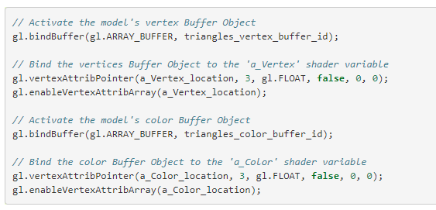
…a little more about attributes
Your shader program can have multiple attribute variables
You need to bind each one to a buffer
For example:

Slide 24

Result…

Slide 25
Can You?
Change the triangle color?
Change the background color?
Change the triangle shape?
Draw multiple triangles?
Figure out what the coordinate system of the canvas is? Where is the origin? What are the coordinates of the bottom left corner? What are the coordinates of the top right corner?

